Slide 1

SCIMITAR+ a trial of a bespoke smoking cessation intervention for people with SMI
Emily Peckham and Della Bailey
University of York

Slide 2
Content
Background
The SCIMITAR programme of work
The bespoke smoking cessation (BSC) intervention
Key findings
The future

Slide 3
Smoking in people with SMI
Prevalence of smoking in people with Serious Mental Ill health (SMI) is high and is a major contributory factor to reduced life expectancy
Smoking is part of the culture and fabric of MH services however
Since 2007 smoking in internal areas of MH units has been illegal
Many Trusts are now implementing complete no smoking bans

Slide 4
Consequences of smoking for those with SMI
Prevalence of smoking 3-4x general population
Poor physical health
Annual health service costs of smoking by adults with mental disorder in UK = £719m (2009/10) (RCP/ RCPsych, 2013)
Early death 20 – 25 years
  Callaghan et al (2014) examined cause of death in 174,277 with a diagnosis of schizophrenia 53% died from smoking related diseases
Tobacco poverty
  people with SMI give back 25-38% of their income to the state based on a 20-30/day habit McCreadie & Kelly (2000)
Increasing health inequalities
Stigma

Slide 5
Smoking is the single most important modifiable risk factor in SMI

Slide 6
SCIMITAR programme aims
1. To develop a bespoke smoking cessation (BSC) intervention; based upon evidence-supported treatments for people with Severe Mental Illness (SMI).
2. To establish the acceptability and uptake of this BSC intervention by people with SMI in primary care and specialist mental health services.
3. To test the feasibility of recruitment and follow up in a pilot trial of a BSC intervention amongst patients with SMI.
4. To establish the clinical effectiveness of a BSC intervention in comparison to existing NHS smoking cessation services delivered under ‘usual care’, in terms of smoking cessation at 12 months
5. To establish the cost effectiveness of a BSC intervention in comparison to existing NHS smoking cessation services delivered under ‘usual care’

Slide 7
Who took part?
97 People with SMI
Long history of smoking – 27 years
Heavy smokers – 25/day (range 5-60)
Overweight BMI - 29

Slide 8
Why do people smoke?
In the general population the most commonly reported motives for smoking were enjoying smoking and stress relief (Fidler & West 2009)
In the SCIMITAR pilot study the three most commonly reported reasons were:
  ‘It helps me to cope with stress’(94%)
  ‘it helps me to relax’ (91%) and
  ‘it is something to do when I am bored’ (86%)

Slide 9
Why did they want to quit?
97% of participants said they wanted to give up because smoking was bad for their health compared to 83% in the general population
83% of SCIMITAR participants cited the expense of smoking as being an important reason for giving up compared to only 31% of the general population
Only 13% were in paid employment

Slide 10
Past history of quit attempts
97% of the participants had attempted to quit at least once in the past
The mean number recent quit attempt was six. The mean length of the most recent quit attempt was 23 days with a range from 0 to 180 days.
70% of all quit attempts had been made by going ‘cold turkey’ and with no additional support

Slide 11
SCIMITAR+
Recruitment commenced October 2015
23 sites
Recruiting in primary and secondary care
Target recruitment of 400
Recruitment closed December 2016
526 people recruited

Slide 12
SCIMITAR+ recruitment

Slide 13
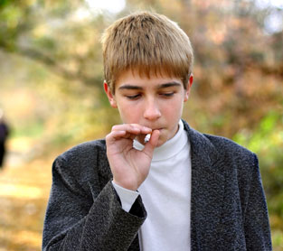
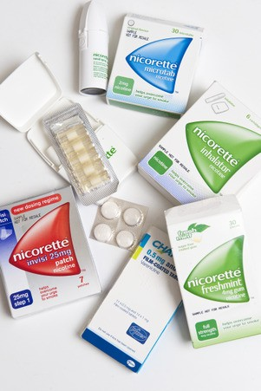
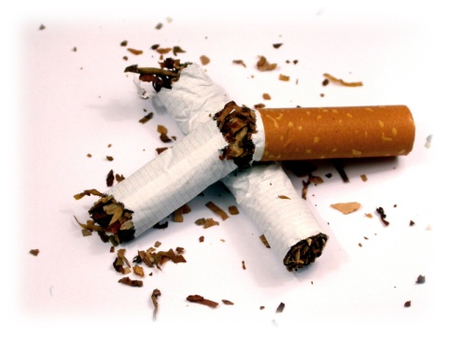
Bespoke Smoking Cessation – the SCIMITAR model
CPN with L2 smoking cessation training
GP or Practice Nurse
Psychiatrist
Behavioural support

Slide 14
Tailored approach
Flexibility on quit date
  Abrupt quit
  Cut down to quit
Venue
NRT support
Number of sessions
Support pack

Slide 15
Experience of standard NHS SSS
I did have one chap that came…and he’d been to normal standard NHS services, and he’d been to a group, and he had a diagnosis of bi-polar, and … she’d given them all a prescription request sheet for Champix,. And he went to see his GP and his GP said, ‘I’m not giving you Champix, you’ve got bi-polar. ’ So he came back next week, and he was the only one in the room that hadn’t been given the Champix. And he said he felt really awkward. ‘How do I explain why I couldn’t have the Champix?’ He said, ‘I didn’t want to tell them it’s because I had a mental health problem.’” MHSCP 1

Slide 16
What people said….
“It wasn’t just a stop smoking clinic for Tom, Dick and Harry, she understood the mental health side, which is obviously a big concern… Because I wouldn’t go to a normal service- because I’m frightened…Well [the MHSCP] knows what I’ve got. Whereas if you go to a normal stop smoking thing and they know you’ve got mental health problems then it’s stigma isn’t it?...”

Slide 17
Case study 1
73 year old man with late onset psychosis
40 cigarettes/day (since age of 20) – C0 40ppm
Motivation – Health (COPD) and Wealth
Quit 16 years ago for 6 years
NRT – Patches and Mouth spray

Slide 18
Case study 1 outcomes
Quit successfully – 3 months – CO 4ppm
Participant’s wife has also quit.
Exercising more, less breathless, reduced use of his inhaler.
Really pleased that he’s managed it.

Slide 19
Case study 2
60 year old man with Schizophrenia
Chronic emphysema, on piped oxygen. Admitted to hospital for pneumonia prior to setting a quit date.
Smoking 30 cigarettes/day – CO 23ppm
Motivation - health
Numerous quit attempts in past
NRT – patch & lozenges

Slide 20
Case study 2 outcomes
Quit successfully. Not smoked for over 3 months. CO 2ppm
Very thankful for the support. Realised he looks and feels a lot better.
Respiratory nurse reported that his lung capacity had doubled since quitting and recommended decreased use of home oxygen.

Slide 21
Case study 3
29 year old woman with schizoaffective Disorder
Smoking 23 cigarettes/day – CO 30ppm
Motivation – health, wealth and family
Several previous quit attempts and had tried NRT
NRT – patch & nasal spray

Slide 22
Case study 3 outcomes
Quit successfully – almost 3 months – CO 3ppm
Has received lots of positive feedback from her family and her partner about how she looks and what she is doing.
Doing a lot more things than she used to and has started helping out at her daughter’s school.

Slide 23
Case study 4
55 year old woman with Bipolar Disorder
Smoking 15 cigarettes/day – CO 18ppm
Health and wealth motivating factors
Several previous attempts without support or NRT
NRT - patch & mouthspray
Changed her morning routine when cravings were worst

Slide 24
Case study 4 outcomes
Successfully quit for over 3 months. CO 3ppm
Reports feeling so much better and wishes she had done it years ago.

Slide 25
Conclusions
Many people with SMI are concerned about the effects of smoking on their health and finances and would like to quit
A bespoke intervention delivered by MH professionals may have additional advantages compared to traditional NHS smoking cessation services

Slide 26
This project was funded by the National Institute for Health Research Health Technology Assessment (project number 11/136/52)
The views and opinions expressed therein are those of the authors and do not necessarily reflect those of the Health Technology Assessment programme, NIHR, NHS or the Department of Health.

